Slide 1
Image Formation and Representation
ENGR 430 Computer Vision
Terminology and first level assumptions
Based on slides from
CS485/685 Computer Vision
Dr. George Bebis
University of Nevada, Reno 2001

Slide 2
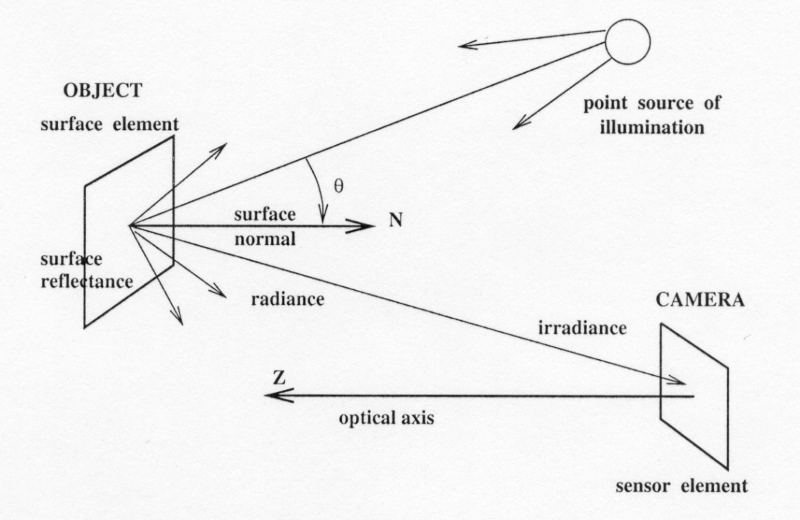
A Simple model of image formation
The scene is illuminated by a single source.
The scene reflects radiation towards the camera.
The camera senses it via solid state cells (CCD cameras)

Slide 3
Image formation (cont’d)
There are two parts to the image formation process:
The geometry, which determines where in the image plane the projection of a point in the scene will be located.
(2) The physics of light, which determines the brightness of a point in the image plane.
Simple model:
f(x,y) = i(x,y) r(x,y)
i: illumination, r: reflectance

Slide 4
Let’s design a camera
Put a piece of film in front of an object - do we get a reasonable image?
Blurring - need to be more selective!
Notes:
4

Slide 5
Let’s design a camera (cont’d)
Add a barrier with a small opening (i.e. aperture) to block off most of the rays
Reduces blurring
Notes:
5
It gets inverted

Slide 6
“Pinhole” camera model
The simplest device to form an image of a 3D scene on a 2D surface.
Rays of light pass through a "pinhole" and form an inverted image of the object on the image plane.
center of
projection
perspective projection:
(X,Y,Z)
(x,y)
f: focal length

Slide 7
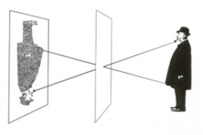
What is the effect of aperture size?
Large aperture: light from the source spreads across the image (i.e., not properly focused), making it blurry!
Small aperture: reduces blurring but (i) it limits the amount of light entering the camera and (ii) causes light diffraction.

Slide 8
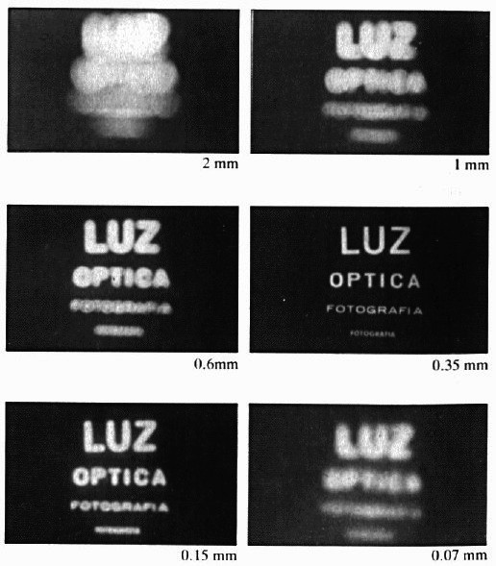
Example: varying aperture size

Slide 9
Example: varying aperture size (cont’d)
What happens if we keep
decreasing aperture size?
When light passes through a small hole, it does not travel in a straight line and is scattered in many directions (i.e., diffraction)
SOLUTION: refraction

Slide 10
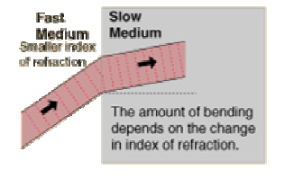
Refraction
Bending of wave when it enters a medium where its speed is different.

Slide 11
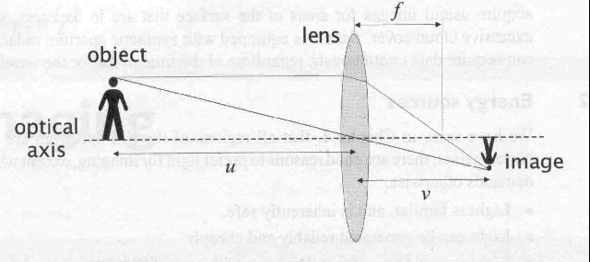
Lens
Lens duplicate pinhole geometry without resorting to undesirably small apertures.
Gather all the light radiating from an object point towards the lens’s finite aperture .
Bring light into focus at a single distinct image point.
refraction

Slide 12
Lens (cont’d)
Lens improve image quality, leading to sharper images.

Slide 13
Properties of “thin” lens (i.e., ideal lens)
focal point
f
Light rays passing through the center are not deviated.
Light rays passing through a point far away from the center are deviated more.
Notes:
13

Slide 14
Properties of “thin” lens (i.e., ideal lens)
focal point
f
All parallel rays converge to a single point.
When rays are perpendicular to the lens, it is called focal point.
Notes:
14

Slide 15
Properties of “thin” lens
focal point
f
The plane parallel to the lens at the focal point is called the focal plane.
The distance between the lens and the focal plane is called the focal length (i.e., f) of the lens.
Notes:
15

Slide 16
Thin lens equation
Assume an object at distance u from the lens plane:
object
v
u
f
image
Notes:
16
This is the relation between the focal length (f), the distance of the object from the camera (D), and the distance at which the object will be in focus (D’)

Slide 17
Thin lens equation (cont’d)
Using similar triangles:
v
u
f
y
y’
y’/y = v/u
image
Notes:
17

Slide 18
Thin lens equation (cont’d)
Using similar triangles:
v
u
f
y
y’
y’/y = (v-f)/f
image
Notes:
18

Slide 19
Thin lens equation (cont’d)
Combining the equations:
v
u
f
1
1
1
+
=
u
v
f
image
Notes:
19
And the set of all such points forms a plane parallel to the image (plane of focus).

Slide 20
Thin lens equation (cont’d)
1
1
1
+
=
u
v
f
“circle of
confusion”
The thin lens equation implies that only points at distance u from the lens are “in focus” (i.e., focal point lies on image plane).
Other points project to a “blur circle” or “circle of confusion”
in the image (i.e., blurring occurs).
Notes:
20

Slide 21
Thin lens equation (cont’d)
focal point
1
1
1
+
=
u
v
f
f
When objects move far away from the camera, then the focal plane approaches the image plane.
Notes:
21

Slide 22
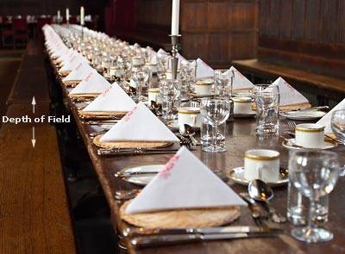
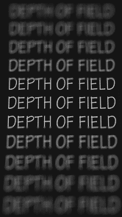
Depth of Field
The range of depths over which the world is approximately sharp (i.e., in focus).
http://www.cambridgeincolour.com/tutorials/depth-of-field.htm
Notes:
22
Depth of field is the range of distance within the subject that is acceptably sharp.

Slide 23
How can we control depth of field?
The size of blur circle is proportional to aperture size.

Slide 24
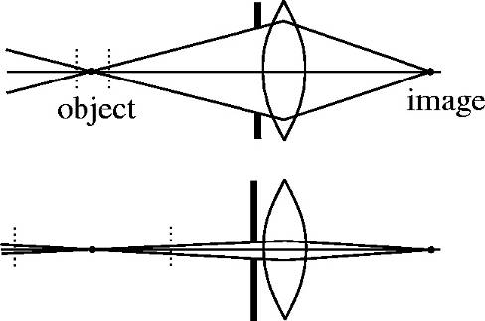
How can we control depth of field? (cont’d)
Changing aperture size (controlled by diaphragm) affects depth of field.
A smaller aperture increases the range in which an object is approximately in focus (but need to increase exposure time).
A larger aperture decreases the depth of field (but need to decrease exposure time).
Notes:
24

Slide 25
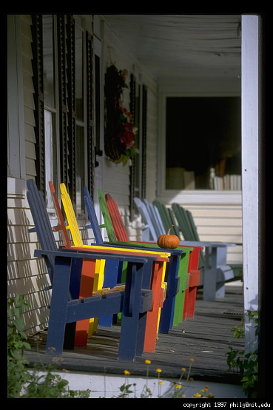
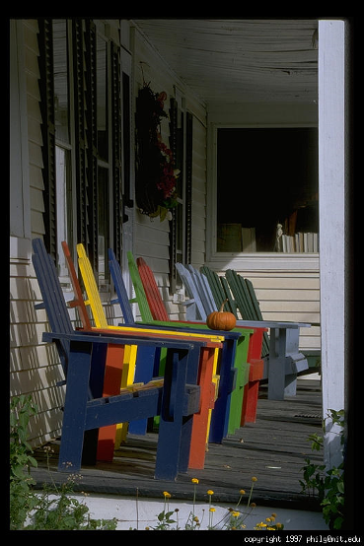
Varying aperture size
Large aperture = small DOF
Small aperture = large DOF
Notes:
25

Slide 26
Another Example
Large aperture = small DOF
Notes:
26

Slide 27
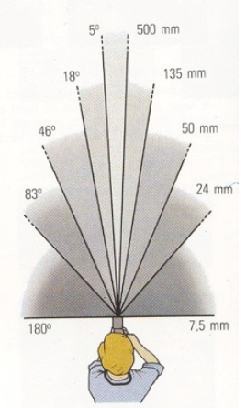
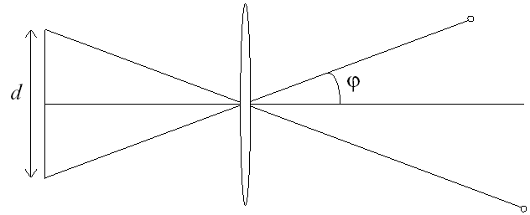
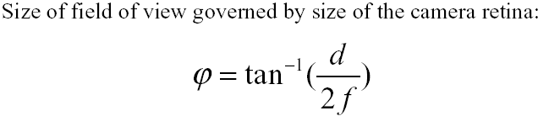
Field of View (Zoom)
The cone of viewing directions of the camera.
Inversely proportional to focal length.
f
f

Slide 28
Field of View (Zoom)
Notes:
28

Slide 29
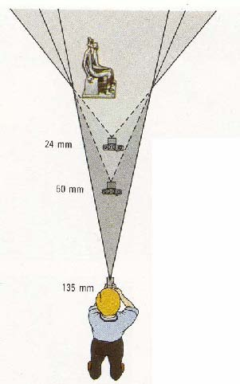
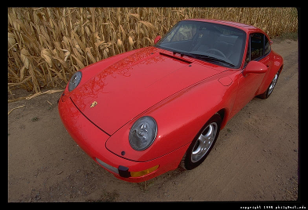
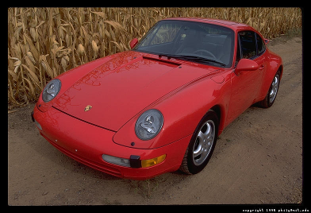
Reduce Perspective Distortions by varying Distance / Focal Length
Small f (i.e., large FOV),
camera close to car
Large f (i.e., small FOV),
camera far from car
Less perspective
distortion!
Notes:
29

Slide 30
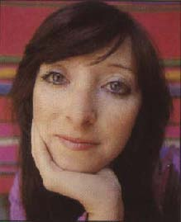
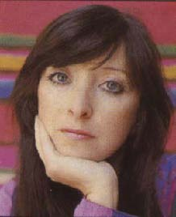

Same effect for faces
Less perspective
distortion!
wide-angle
standard
telephoto
Practical significance: we can approximate perspective projection
using a simpler model when using telephoto lens to view a distant
object that has a relatively small range of depth.
Notes:
30

Slide 31
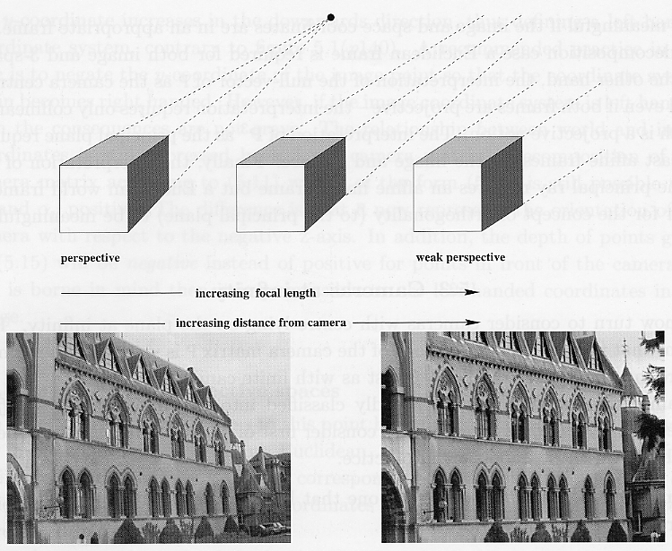
Approximating an “affine” camera
Center of projection is at infinity!

Slide 32
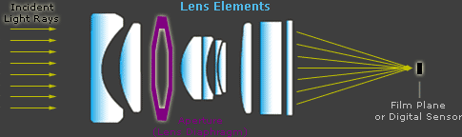
Real lenses
All but the simplest cameras contain lenses which are actually
comprised of several "lens elements."
Each element aims to direct the path of light rays such that they
recreate the image as accurately as possible on the digital sensor.
Notes:
32

Slide 33
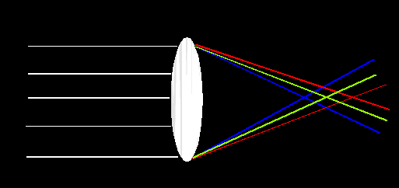
Lens Flaws: Chromatic Aberration
Lens has different refractive indices for different wavelengths.
Could cause color fringing:
i.e., lens cannot focus all the colors at the same point.

Slide 34
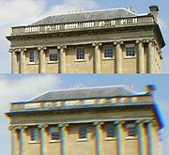
Chromatic Aberration - Example

Slide 35
Lens Flaws: Radial Distortion
Straight lines become distorted as we move further away from the center of the image.
Deviations are most noticeable for rays that pass through the edge of the lens.

Slide 36
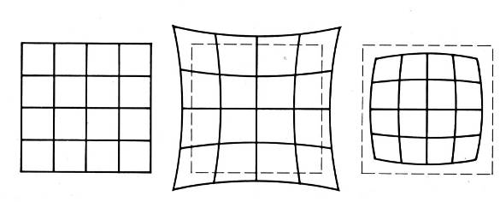
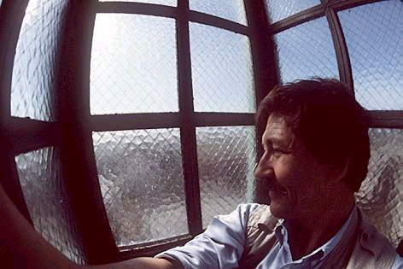
Lens Flaws: Radial Distortion (cont’d)
No distortion
Pin cushion
Barrel

Slide 37
Lens Flaws: Tangential Distortion
Lens is not exactly parallel to the imaging plane!

Slide 38
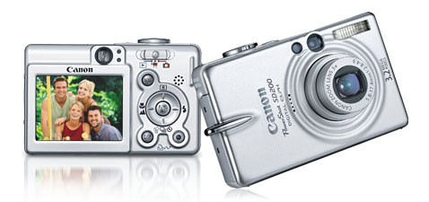
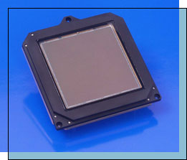
Digital cameras
A digital camera replaces film with a sensor array.
Each cell in the array is light-sensitive diode that converts photons to electrons
Two common types
Charge Coupled Device (CCD)
Complementary metal oxide semiconductor (CMOS)
http://electronics.howstuffworks.com/digital-camera.htm
Notes:
38

Slide 39

Digital cameras (cont’d)

Slide 40
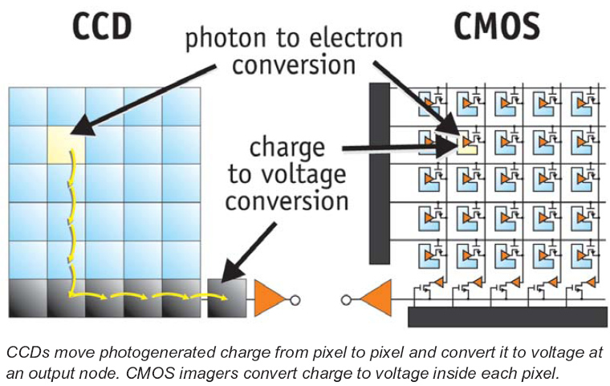
CMOS Cameras
CMOs convert charge to voltage inside each element.
Uses several transistors at each pixel to amplify and move the charge using more traditional wires.
The CMOS signal is digital, so it needs no ADC.
http://www.dalsa.com/shared/content/pdfs/CCD_vs_CMOS_Litwiller_2005.pdf
Notes:
40

Slide 41
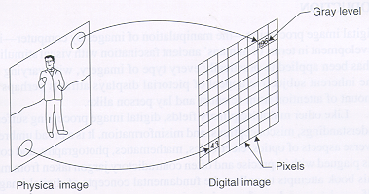
Image digitization
Sampling: measure the value of an image at a finite number of points.
Quantization: represent measured value (i.e., voltage) at the sampled point by an integer.

Slide 42
Image digitization (cont’d)
Sampling
Quantization

Slide 43
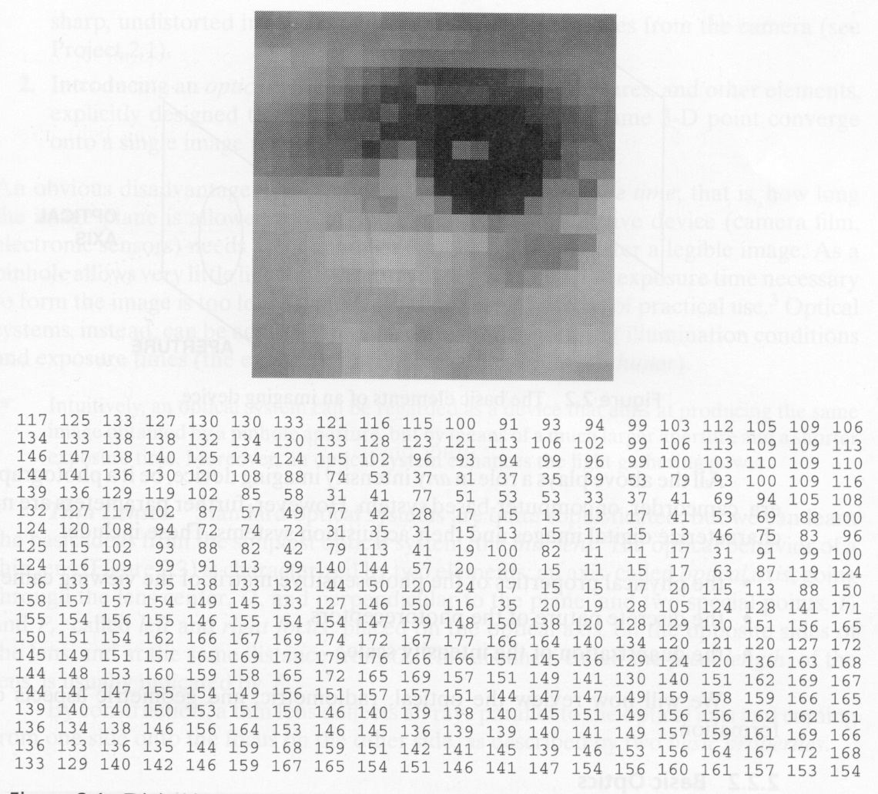
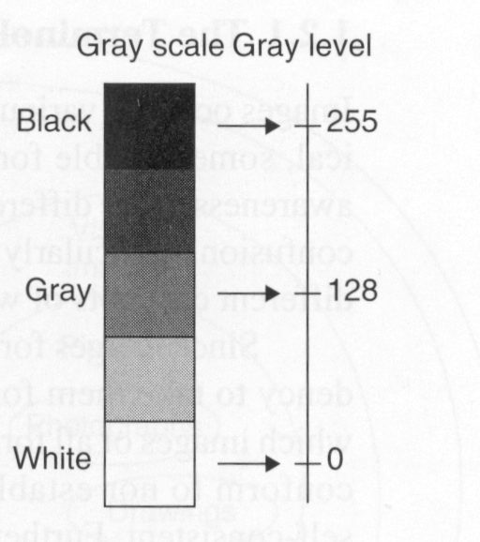
What is an image?
8 bits/pixel
0
255

Slide 44
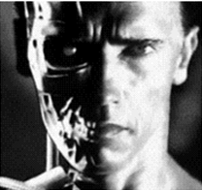
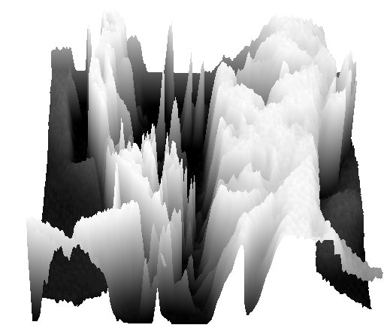
What is an image? (cont’d)
We can think of a (grayscale) image as a function, f, from R² to R (or a 2D signal):
f (x,y) gives the intensity at position (x,y)
A digital image is a discrete (sampled, quantized) version of this function
f (x, y)
x
y

Slide 45
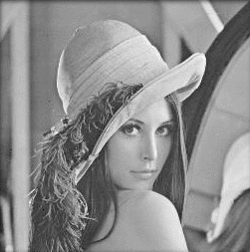


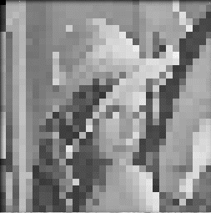
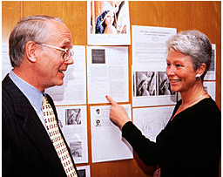
Image Sampling - Example
original image sampled by a factor of 2
sampled by a factor of sampled by a factor of 8
Images have
been resized
for easier
comparison
Lena Söderberg

Slide 46


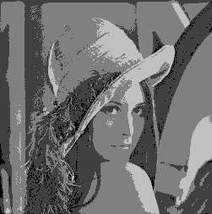
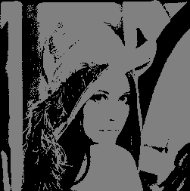
Image Quantization - Example
256 gray levels (8bits/pixel) 32 gray levels (5 bits/pixel) 16 gray levels (4 bits/pixel)
8 gray levels (3 bits/pixel) 4 gray levels (2 bits/pixel) 2 gray levels (1 bit/pixel)

Slide 47

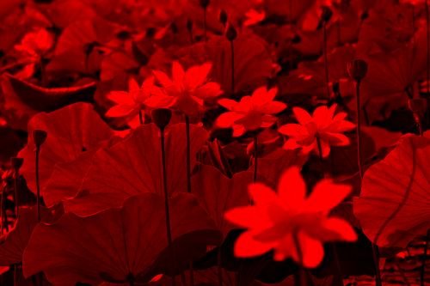
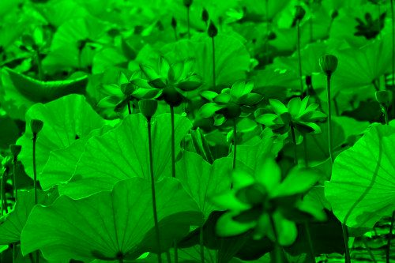
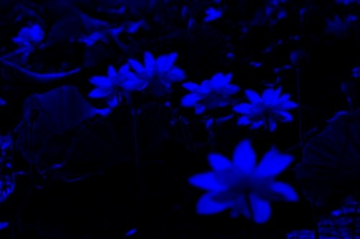
Color Images
Color images are comprised of three color channels – red, green, and, blue – which combine to create most of the colors we can see.
=

Slide 48
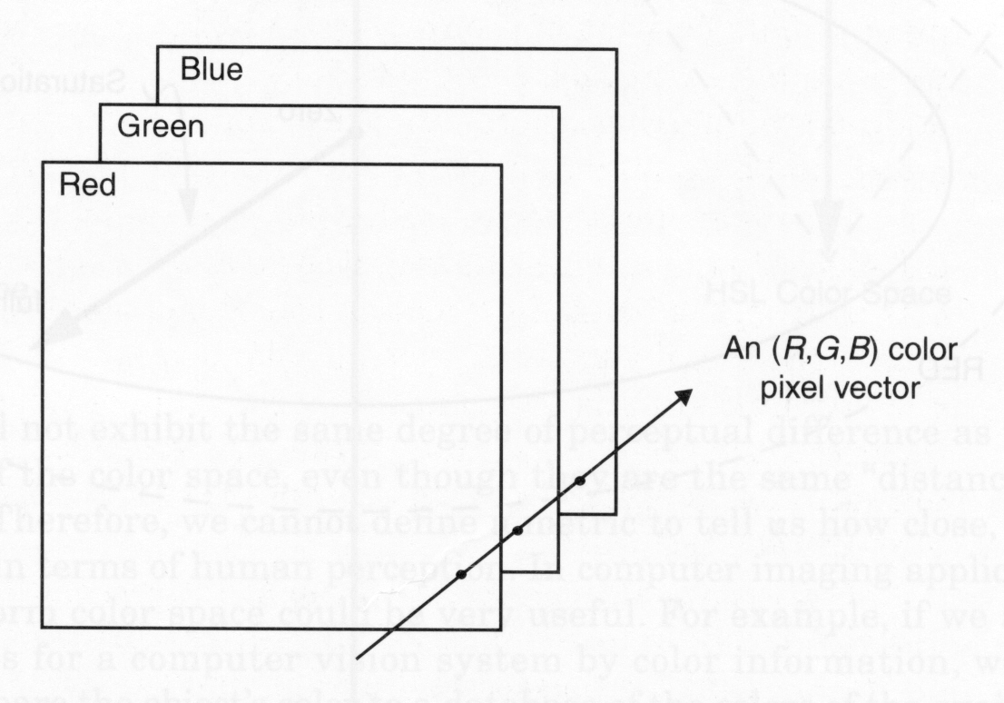
Color images

Slide 49
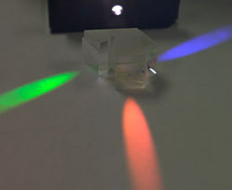
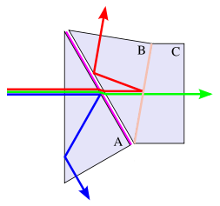
Color sensing in camera: Prism
Requires three chips and precise alignment.
CCD(R)
CCD(G)
CCD(B)

Slide 50
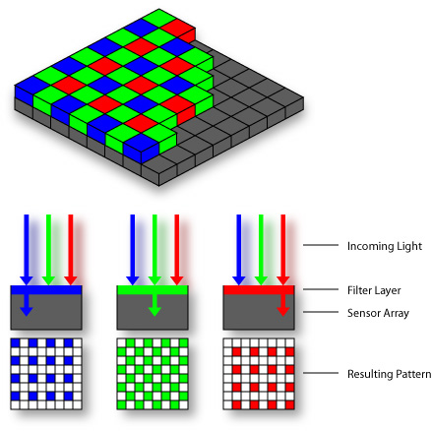
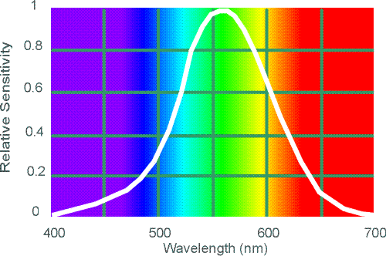
Color sensing in camera: Color filter array
In traditional systems, color filters are applied to a single
layer of photodetectors in a tiled mosaic pattern.
Bayer grid
Why more green?
Human Luminance Sensitivity Function

Slide 51




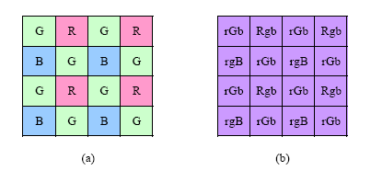
Color sensing in camera: Color filter array
red
green
blue
output
demosaicing
(interpolation)

Slide 52
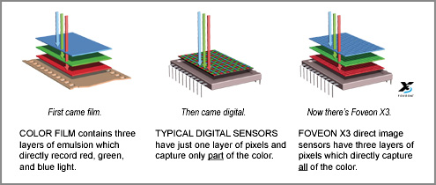
Color sensing in camera: Foveon X3
CMOS sensor; takes advantage of the fact that red, blue and green light silicon to different depths.
http://www.foveon.com/article.php?a=67

Slide 53
Alternative Color Spaces
Various other color representations can be computed from RGB.
This can be done for:
Decorrelating the color channels:
principal components.
Bringing color information to the fore:
Hue, saturation and brightness.
Perceptual uniformity:
CIELuv, CIELab, …

Slide 54
Alterative Color paces
RGB (CIE), RnGnBn (TV - National Television Standard Committee)
XYZ (CIE)
UVW (UCS de la CIE), U*V*W* (UCS modified by the CIE)
YUV, YIQ, YCbCr
YDbDr
DSH, HSV, HLS, IHS
Munsel color space (cylindrical representation)
CIELuv
CIELab
SMPTE-C RGB
YES (Xerox)
Kodak Photo CD, YCC, YPbPr, ...

Slide 55
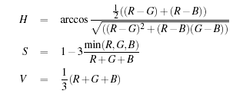
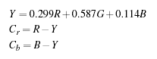
Color Transformation - Examples

Slide 56
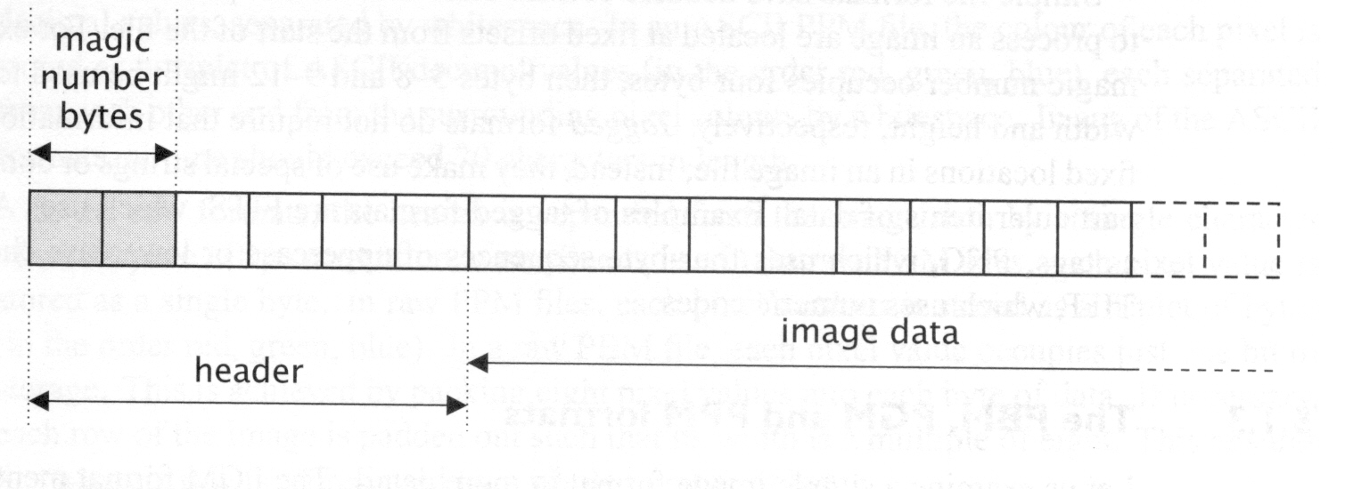
Image file formats
Many image formats adhere to the simple model shown below (line by line, no breaks between lines).
The header contains at least the width and height of the image.
Most headers begin with a signature or “magic number”
(i.e., a short sequence of bytes for identifying the file format)

Slide 57
Common image file formats
GIF (Graphic Interchange Format) -
PNG (Portable Network Graphics)
JPEG (Joint Photographic Experts Group)
TIFF (Tagged Image File Format)
PGM (Portable Gray Map)
FITS (Flexible Image Transport System)

Slide 58


PBM/PGM/PPM format
A popular format for grayscale images (8 bits/pixel)
Closely-related formats are:
PBM (Portable Bitmap), for binary images (1 bit/pixel)
PPM (Portable Pixelmap), for color images (24 bits/pixel)
ASCII or binary (raw) storage
ASCI
Binary

